Slide 1



COVID-19 Vaccination
CO-WIN 2.0: State Orientation Meeting
Karnataka
5th March 2021

Slide 2
COVID-19 vaccine doses administered as on 4th March 2021
Category | HCWs |  | FLWs |  | 45 to <60 years with co-morbidities | Over 60 years | Total
Dose | 1st Dose | 2nd Dose | 1st Dose | 2nd Dose | 1st Dose | 1st Dose
India | 68,38,077 | 30,82,942 | 60,22,136 | 54,177 | 2,18,939 | 14,95,016 | > 1.77 Crore
Karnataka | 4,51,268 | 2,21,206 | 1,64,308 | 6 | 5,680 | 37,847 | > 8.8 Lakh
  More than 1.77 crore beneficiaries safely vaccinated in the country through effective Co-ordination among public and private sectors

Slide 3
NEXT PHASE – COWIN 2.0
Eligible Beneficiary
  All Health Care Workers and Frontline Workers as specified by the MoHFW
  All citizens that are aged 60 years or more as on 1st January 2022
    Persons born before 1st January 1962
  All such citizens that are aged 45 years to 59 years as on 1st January 2022, that have any of the specified comorbidities – (20) – Annexure 1(A)
    Persons born during 1st January 1962 and 1st January 1977
    Subject to certification to that effect by a Registered Medical Practitioner – Annexure 1(B)

Slide 4
NEXT PHASE – COWIN 2.0
Annexure 1A- For beneficiaries aged 45 years to 59 years as on 1st January 2022, that have any of the specified comorbidities
1. Heart Failure with hospital admission in past one year | 11. Kidney/ Liver/ Hematopoietic stem cell transplant: Recipient/On wait-list
2. Post Cardiac Transplant/Left Ventricular Assist Device (LVAD) | 12. End Stage Kidney Disease on haemodialysis/ CAPD
3. Significant Left ventricular systolic dysfunction (LVEF <40%) | 13. Current prolonged use of oral corticosteroids/ immunosuppressant medications
4. Moderate or Severe Valvular Heart Disease | 14. Decompensated cirrhosis
5. Congenital heart disease with severe PAH or Idiopathic PAH | 15. Severe respiratory disease with hospitalizations in last two years/FEV1 <50%
6. Coronary Artery Disease with past CABG/PTCA/MI AND Hypertension/Diabetes on treatment | 16. Lymphoma/ Leukaemia/ Myeloma
7. Angina AND Hypertension/Diabetes on treatment | 17. Diagnosis of any solid cancer on or after 1st July 2020 OR currently on any cancer therapy
8. CT/MRI documented stroke AND Hypertension/Diabetes on treatment | 18. Sickle Cell Disease/ Bone marrow failure/ Aplastic Anemia/ Thalassemia Major
9. Pulmonary artery hypertension AND Hypertension/Diabetes on treatment | 19. Primary Immunodeficiency Diseases/ HIV infection
10. Diabetes (> 10 years OR with complications) AND Hypertension on treatment | 20. Persons with disabilities due to Intellectual disabilities/ Muscular Dystrophy/ Acid attack with involvement of respiratory system/ Persons with disabilities having high support needs/ Multiple disabilities including deaf-blindness

Slide 5
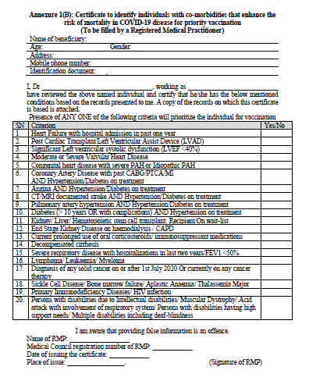
Annexure 1A- Co-morbidity Certificate (Applicable for 45 to 59 years age)

Slide 6
TERMS & DEFINITIONS
COVID Vaccination Centers (CVCs) – must be only “health facilities”
Government CVCs- All facilities up to level of PHCs
  PHCs, UPHCs, CHCs, Taluk hospitals, District Hospitals, Government Medical College Hospitals, etc.
Private CVCs-
  PMJAY/CGHS/AB-ArK Empaneled: All Private Hospitals empanelled under Central Government Health Scheme (CGHS), Ayushman Bharat- Pradhan Mantri Jan Arogya Yojana (AB-PM JAY) and Ayushman Bharat Arogya Karnataka Schemes.
  Private Hospitals which are not empaneled under any scheme can also be included as CVCs
  Private CVCs must have
    Cold chain capacity- ILR or Refrigerator
    Sufficient rooms
    Trained vaccinators
    AEFI management capacity
  Vaccination will be provided free of charge at the Government Health Facilities
  On payment basis in the Private Health Facilities – with a ceiling of Rs:250 per dose

Slide 7
COVID-19 Vaccination in Private Hospitals
Private hospitals functioning as CVCs can charge subject to a ceiling of Rs. 250 per person per dose ( upto Rs:100 service charge & Rs: 150 cost of vaccine)
When the vaccines are handed over to private facilities, the cost of vaccine @ Rs: 150 per dose is to be electronically deposited immediately by the hospital in the bank account of National Health Authority (NHA)
  Name of Account: “National Health Authority Covid Vaccination”
  Bank Details: State Bank of India, Main branch, New Delhi, Account Number-40038441558, IFSC Code: SBIN0000691
Soon Multiple credit options will be provided though payment gateway on https://pmjay.gov.in/ . Details will be communicated.

Slide 8
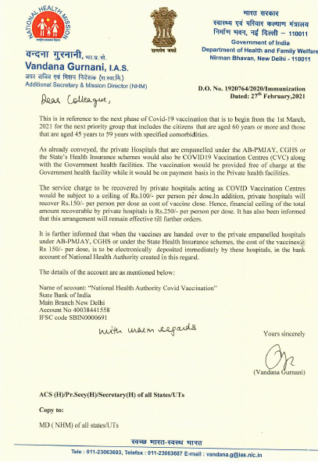
COVID-19 Vaccination in Private Hospitals

Slide 9
COVID-19 Vaccination in Private Hospitals
Co-WIN Vaccinator App on Google Play Store: https://play.google.com/store/apps/details?id=com.cowinapp.app
Co-WIN Portal login website: https://www.cowin.gov.in/home
Co-WIN User Names and Passwords will be provided to the private facilities: Three types on login credentials for each private hospitals
  Site Manager Credentials
  Verifier
  Vaccinator
One nodal officer from private hospital should be designation for COVID-19 vaccination co-ordination
One government health supervisor will be tagged to each of the private CVC in the district (Health inspector, LHV/SHA, BHEO, etc.)- Daily co-ordination and supportive supervision
Please co-ordinate regularly with Medical officer of the Govt hospital handing over vaccines, District control room and District RCH officer

Slide 10
Contact Details of District RCH officers
Name of District RCH Officer | Mobile Number | Email ID | District
Dr. Basavaraj Gurulingappa Hubballi | 6361367737 | rchobagalkote@gmail.com | Bagalkote
Dr.Anil Kumar R | 9901914534 | rchobellary@gmail.com | Ballari
Dr.Sharmila Hede | 9449843183 | rchobangalorerural@gmail.com | Bangalore Rural
Dr.Sirajuddin Madani | 9845208571 | rchobangaloreurban@gmail.com | Bangalore Urban
Dr. Sudharshana BY | 9448055948 | iobbmp@gmail.com | BBMP
Dr.Ishwarappa Gadad | 9449843184 | rchobelgaum@gmail.com | Belagavi
Dr.Mahesh Biradar | 9448568187 | rchobidar@gmail.com | Bidar
Dr.Vishveshwarayya K M | 9740554068 | rchochamarajanagar@gmail.com | Chamarajanagar
Dr.Bharat Kumar K | 9448135742 | rchochikmagalur@gmail.com | Chikamagalur
Dr.Channakeshava Reddy M | 9449843191 | rchochikballapura@gmail.com | Chikkaballapura
Dr.Kumaraswamy P C | 9886437902 | rchochitradurga@gmail.com | Chitradurga
Dr.Rajesh B V | 8296417555 | rchodkannada@gmail.com | Dakshina Kannada
Dr.Meenakshi | 9481520707 | rchodavangere@gmail.com | Davanagere
Dr.Honakeri S M | 8277332970 | rchodharwad@gmail.com | Dharwad
Dr.BharAmappa M Gojanur | 9449843196 | rchogadag@gmail.com | Gadag
Dr.Kantaraju K P | 9449843200 | rchohassan1@gmail.com | Hassan
Dr.Jayanand M | 9449843198 | rchohaveri@gmail.com | Haveri
Dr.Prabhuling K Mankar | 9060189258 | rchogulbarga@gmail.com | Kalaburagi
Dr.Gopinath S | 9449843203 | rchokodagu2@gmail.com | Kodagu
Dr.Vijayakumari | 7795647885 | rchokolar@gmail.com | Kolar
Dr.Jambayya B | 9449843201 | rchokoppal3@gmail.com | Koppal
Dr.Somashekara M C | 9844277163 | rchomandya@gmail.com | Mandya
Dr.Ravi L | 9449843205 | rchomysore@gmail.com | Mysore
Dr.Vijaya K | 9902569922 | rchoraichur@gmail.com | Raichur
Dr.Padma G L | 9449843206 | rchoramanagaram@gmail.com | Ramanagara
Dr.Nagaraj Naik L | 9845636926 | rchoshimoga@gmail.com | Shimoga
Dr.Keshavraj G | 9448432599 | rchotmk@gmail.com | Tumkur
Dr.M G Rama | 9902963542 | rchoudupi@gmail.com | Udupi
Dr.Ramesh Rao | 9448842797 | rchoukannada@gmail.com | UttaraKannada
Dr.Mahesh Nagarabetta | 9449843188 | rchobijapur@gmail.com | Vijayapura
Dr.Suryapraksh M Kandkoor | 9449843382 | rchoyadgiri@gmail.com | Yadgir

Slide 11
COVID-19 Vaccination in Private Hospitals
While Receiving vaccine: Ensure proper acknowledgement in duplicate:
  Date Received
  Vaccine type
  number of vials handed over
  batch number and expiry of vaccine
  Supplied in good cold chain (conditioned ice-packs), receiving person-name, designation, sign, etc.
Private Hospitals for Covid vaccination
  should have adequate space for each session (3 rooms), 5 members per each team, accordingly can decide sessions per day.
  Should have ILR or refrigerator exclusively for storing vaccines. With uninterrupted power supply and temperature monitoring
  Should be trained in AEFI management and reporting.
  Should have facility to manage and refer AEFI appropriately
  should vaccinate only through Co-WIN and only to eligible beneficiaries.
  All Vaccinations at private health facilities will be charged from March 1st
  Govt will be providing only vaccine vials to private hospitals (Syringes and other logistics will not be provided)

Slide 12
Ramping up COVID-19 vaccination from 8th March
From 8th March 2021 (Monday) onwards, districts should plan sessions at
  All PHCs
  All UPHCs
  All CHCs
  All Taluka hospitals
  All district hospitals
  All Government and private medical colleges
  Selected Private hospitals (who agree to do COVID vaccination)
All CVCs should facilitate vaccination of HCW, FLW also for both first and second doses
Days of Vaccination:
  Can function on all days of week as per feasibility and in co-ordination with District DHO and RCHO

Slide 13
Ramping up COVID-19 vaccination from 8th March
Timings of Session Site:
  All sessions can be scheduled for full day: 10 am to 4 pm
  Flexibility shall be allowed for private hospitals in consultation with district RCHO
Number of vaccinations per day: (Only indicative- District administration can decide as per feasibility)
  Private Hospitals upto 200 bedded private hospital- 100 vaccinations per day shall be allowed
  Private hospitals above 200 beds- to be decided based on availability of space and dedicated HR for COVID vaccination
Plan for training of all staff
Plan reorientation meetings for vaccination teams

Slide 14
Ramping up COVID-19 vaccination from 8th March
Ensuring physical distancing and COVID appropriate behaviours at session sites
Crowd management, token system, announcements
Information desk, directions at hospitals
Active Mobilisation can also be planned in coming weeks;
  Facilitated cohort mobilisation of elderly and 45 to 59 years with co-morbidity with specific slots or specific days
  Co-ordination with resident welfare associations
  Co-ordination with corporates
Continue vaccination of hospital/facility staff due for first dose and second dose under HCW category

Slide 15
TERMS & DEFINITIONS – Vaccination slots
1. Reserved Slots – Further classified as
  Mobilization slots – for Facilitated cohort registration
    Slots for on-site registration, appointment, verification and vaccination (all on-site on the same day).
    No need for pre-registering beneficiaries through online interface
  Slots reserved for 2nd dose
    Who have already received 1st dose, including HCWs, FLWs and citizens, at a CVC.
    Will be populated by COWIN System
2. Open slots – for online registration and appointments
    Open Slots = (Total Capacity – Reserved Slots)

Slide 16
Documents Required
All beneficiaries, regardless of the mode of access, must be advised to carry the following – may be suitably publicized too.
    Aadhar Card; or any one of 7 valid photo ID
    Certificate of comorbidity for citizens in age group of 45 years to 59 years- signed by Registered Medical Practitioner in prescribed Annexure 1B
    Employment certificate/ Official Identity Card – (either but with photo) for HCWs and FLWs. (as per MoHFW guidelines irrespective of age or co-morbidity)
The Photo ID card specified at the time of registration in case of online registration. (Any one of following Photo ID with age/DOB can be accepted)
    Aadhar card
    Election ID (EPIC)
    Passport
    Driving License
    PAN
    NPR smart card
    Pension document with photograph

Slide 17
Verification, vaccination and certification
Three types of credentials for each Health facility
  Manager
  Verifier
  Vaccinator
Multiple Verifiers and Vaccinators can be assigned for a session at the CVC.
The full list of beneficiaries, as available in COWIN, will be visible to all verifiers and vaccinators designated for a session, i.e. all verifiers and vaccinators will work on the same full list.
Verification will be done by Verifier (Vaccination Officer 2).
Verification of eligibility and identity of beneficiary at a CVC will preferably be done using Aadhar.
In case Aadhar authentication is not possible at a CVC for any reason, the Verifier will verify the identity and eligibility of the beneficiary from the photo ID Card brought by the beneficiary

Slide 18
Verification, vaccination and certification
MADATORY TO ENSURE BY ALL
If the identity and eligibility of a beneficiary is established upon verification, the beneficiary will be vaccinated and his/her vaccination status will be updated, else the “beneficiary will not be vaccinated”.
All Vaccination Events must be recorded in real time through the CO-WIN Vaccinator Module.
No offline vaccination shall be done. No facility for backlog entry henceforth.
Strictly ensure vaccination of eligible beneficiaries only

Slide 19
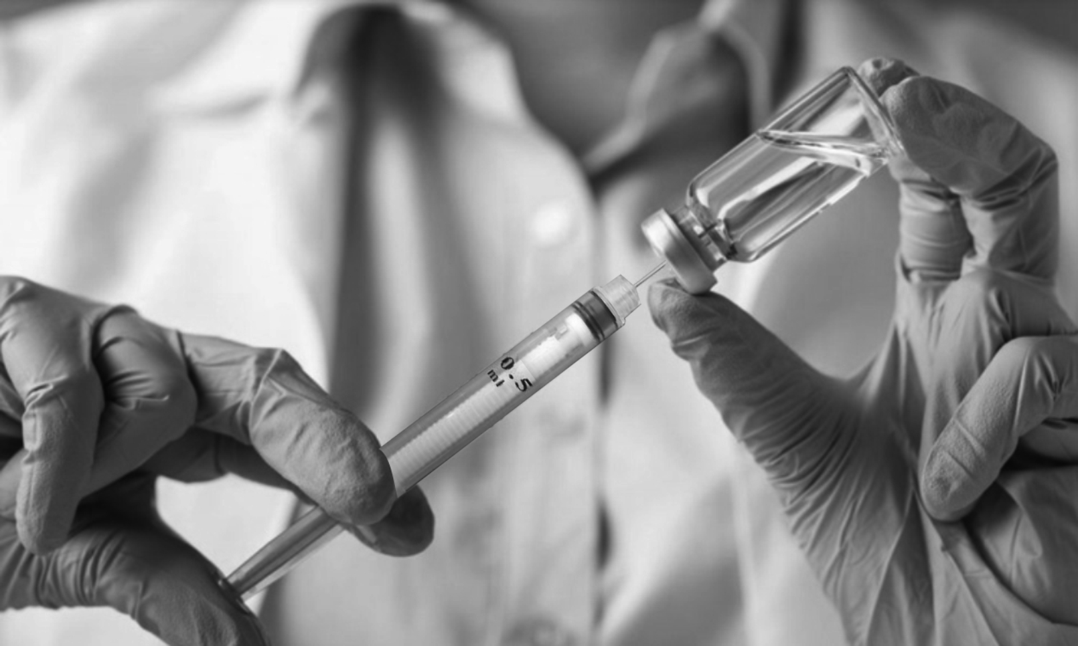




Vaccination Session,
Vaccine Cold Chain & Immunization Waste Management at Session Sites

Slide 20
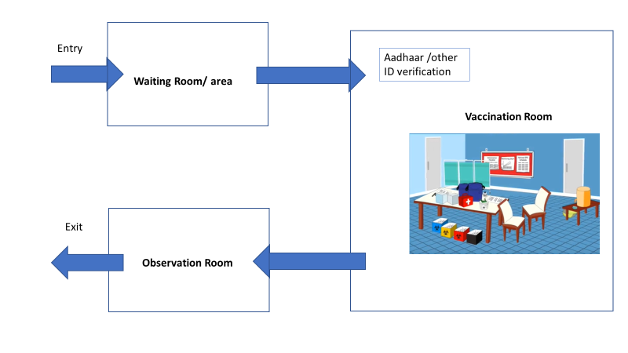
How to set up a vaccination site
Designate a separate entry and exit if possible
Open windows for ventilation
Designate three separate rooms or areas
  Waiting room/ area
  Vaccination Room
  Observation Room
Ensure adequate physical distance between chairs/ seats in waiting rooms
Avoid criss-cross movement of beneficiaries at session site
  Make arrow marks/foot step marks to show directions

Slide 21
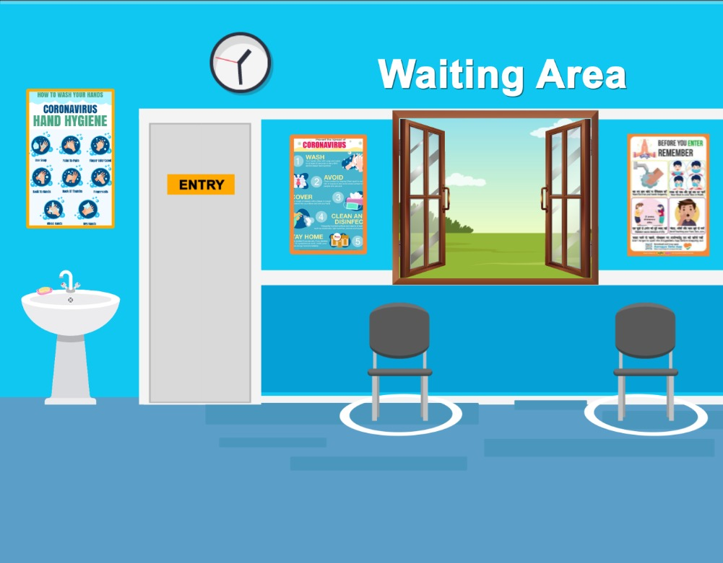
Waiting Area
Facility for hand washing/ sanitization at entrance
Seating arrangement to ensure physical distancing of 2 gaja/ 6 feet
Only one person to enter vaccination room at a time
Communication materials on COVID appropriate behaviour (hand hygiene, use of mask and physical distancing) to be displayed

Slide 22
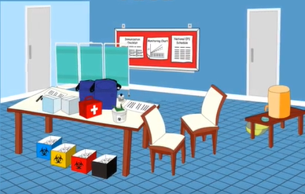
Vaccination Room
Only one beneficiary to enter vaccination room at a time to ensure privacy
Logistics to be made available
  2 vaccine carriers with 4 conditioned ice packs each
  Adequate COVID-19 vaccine vials in one of the vaccine carriers
  Adequate numbers of AD syringes
  Hand sanitizer and masks
  Vaccine vial opener
  Hub cutter
  Partition Screen
  AEFI/Anaphylaxis kit
  Red and yellow bags, blue puncture proof container, bag for municipal waste

Slide 23
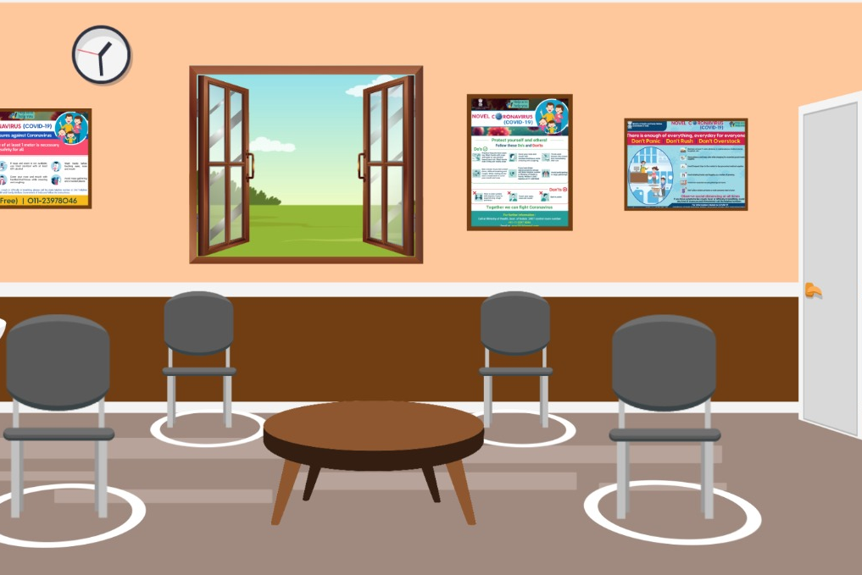
Observation Room
Will require more space as beneficiaries will wait for 30 minutes after vaccination
Seating arrangement to ensure physical distancing of 6 feet
Communication materials on COVID appropriate behaviour to be displayed
Drinking water and toilet facility should be available

Slide 24
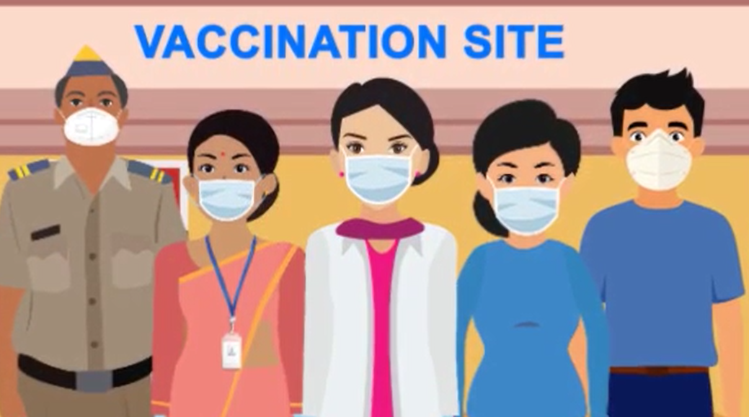
Guidance for Vaccination Teams
Reach allocated session site before time
Inform supervisor/ Medical Officer if you are sick
Wear a mask at all times
Composition of team
  4 Vaccination Officers with defined roles
  1 Vaccinator Officer
Make list of team members for each booth; seek support from other line departments; letters from district administration for deputation on day of training and vaccination session

Slide 25
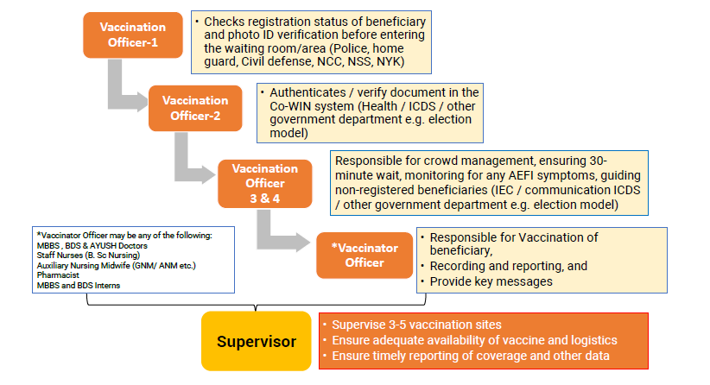
Roles of Vaccination Team Members

Slide 26
Vaccine specifications
Liquid vaccine, intramuscular injection, 2 dose schedule, 0.5 ml per dose,
10 doses (Covishield) or 20 doses (Covaxin) per vaccine vial
Physical appearance is clear to slightly opaque, colorless to slightly brown
Cold chain space volume per dose is 2.1 ml (Covishield)/ 1.7 ml (Covaxin)
Recommended storage temperature is +2 to +8 Deg C
Shake test is not applicable
Freeze sensitive vaccine
No VVM on the vial
Open Vial Policy is not applicable, Mention date/ time on vial immediately after opening- Discard after 4 hours
Shelf life is approximately 6 months from date of manufacturing
Ensure Early Expiry First out (EEFO)
Do not stock buffer unnecessarily at any level

Slide 27
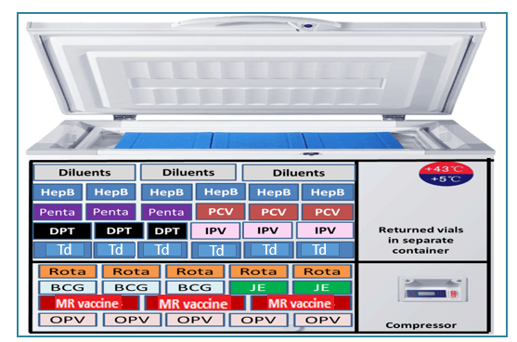
COVID vaccine storage in ILR and domestic refrigerator
COVID vaccine

Slide 28
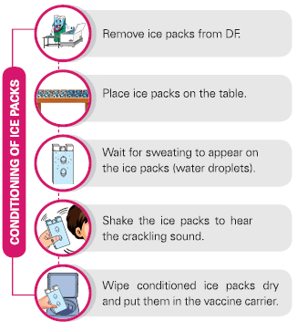
Ice pack conditioning

Slide 29
Vaccine and Cold Chain Management
All private health facilities serving as CVCs will receive and store vaccines, managed through Co-WIN/ eVIN
Ensure that the institution has the adequate number of CCE for vaccine storage as per the vaccine dose requirement- ILR or refrigerator
Only COVID-19 vaccines to be stored in identified equipment at private facilities – no other items or vaccines to be stored
Ensure that all CCE are functional before the activity and continuous power supply available for CCE
Twice daily monitoring of CCE temperature to be ensured and monitored by facility in charge
Contingency plan for vaccine storage in cold boxes or shifting to alternate locations to be prepared and ready to be implemented in case of power supply issues or other contingencies
In case of any CCE break down, private facility in charge/RCHO to be immediately informed for ensuring repairs or replacement
Adequate space to be ensured for storing syringes and other immunization logistics
Review of vaccine stock position after every session and weekly physical stock audit

Slide 30
Management during COVID Vaccination session at CVCs
Ensure that the vaccine from same manufacturer is administered to the beneficiary for 2nd dose
Never expose the vaccine carrier, vial or icepack to direct sunlight
All vaccines should be kept inside the vaccine carrier/ refrigerator with the lid/ door closed until a beneficiary comes for vaccination
Keep the COVID vaccine on the table and not on the ice pack
Never pre-fill syringes
All open vaccine vials need to be discarded after 4 hours of opening or at the end of session – date and time of opening of vials needs to be written on the vial
Use all vaccine contents in a vial before opening a new vial.
At the end of the session, the vaccine carrier with all icepacks and unopened vaccine vials should be sent back to the cold chain point and stored in the ILR/ refrigerator
Unopened vials from the previous session have to be prioritized for use during the next session
Ensure adequate safety and security arrangements for the vaccines to prevent pilferage and theft

Slide 31
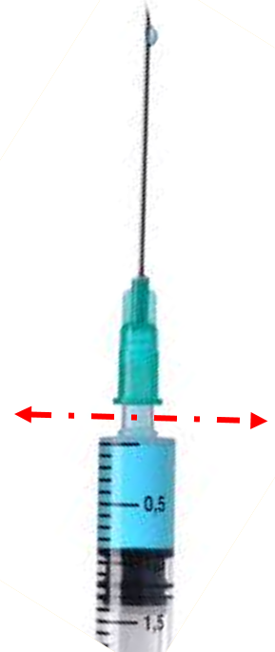
Steps to ensure safe disposal of immunization waste at session sites
(public and private sector)
Step 1: At the session site, vaccinators cut the hub of the AD syringe immediately after administering the injection using the hub cutter. The cut needles will get collected in the puncture-proof container of the hub cutter
Step 2: Segregate and store the plastic portion of the cut syringes in the red bag or container. The bags/ container should bear the biohazard symbol
Step 3: Store the broken vaccine vials in a separate blue container, used cotton swab in the yellow bag

Slide 32
Steps to ensure safe disposal of immunization waste at session sites (public and private sector)
Step 4: Plastic wrapper, cap of the syringe, PCM wrappers and any other packaging material should be segregated as general waste
Step 5: The used and unused vaccine vials should be returned to the CCP as per existing AEFI guidelines for proper disposal
Step 6: At the end of the session- send the Red bag, Yellow bag, Blue bag/container and the hub cutter to CCP for further disinfection and disposal or handing over to Common Biomedical Waste Treatment Facility (CBWTF)
Note-
General Waste Bag may be of any colour and will not carry biohazard symbol
In case of disposal of face mask, PPE etc. at session, protocol for COVID-19 waste management July 2020 should be followed

Slide 33
COVID Vaccination at Private facility
Private facility should have ILR or Refrigerator for exclusively storing vaccines
There should be uninterrupted power supply/ power back-up
With temperature monitoring device and temperature chart-twice daily recording
COVID vaccine vial should not be used beyond 4 hours of opening under any circumstances.
Mention date/time on vial immediately after opening
Use a new syringe for every vaccination
Never place partially used/open vials in an ILR/refrigerator
Every beneficiary should wait for 30 minutes after vaccination at the facility to observe for any immediate AEFI
AEFI management kit/Anaphylaxis kit should be present at the CVC
Every AEFI should be reported on Co-WIN and serious AEFI should be immediately intimated to RCHO
Strict injection safety precautions to be maintained
Waste disposal as per standard guidelines

Slide 34
Adverse Event Following Immunization (AEFI)

Slide 35
AEFI: DEFINITION
“An adverse event following immunization (AEFI) is any untoward medical occurrence which follows immunization, and which does not necessarily have a causal relationship with the usage of the vaccine.
The adverse event may be any unfavorable or unintended disease, symptom, sign or abnormal laboratory finding.”

Slide 36
TYPES OF AEFI FOR REPORTING
For purpose of reporting, AEFIs can be minor, severe and serious.
Minor AEFI | Severe AEFI | Serious AEFI
Common, self limiting reactions Examples: pain, swelling at injection site, fever, irritability, malaise etc. | Can be disabling and rarely life threatening do not lead to long-term problems Examples of severe reactions include non-hospitalized cases of anaphylaxis that has recovered, high fever (>102-degree F), etc. | Results in death Requires inpatient hospitalization Results in persistent or significant disability AEFI cluster Evokes significant parental/community concern

Slide 37
Contraindications for COVID 19 vaccine
Person with history of:
  Anaphylactic or allergic reaction to a previous dose of COVID 19 vaccine
  Immediate or delayed onset anaphylaxis or allergic reaction to vaccines or injectable therapies, pharmaceutical products, food-items etc.
Pregnancy and lactation:
  Pregnant & lactating women have not been part of any COVID 19 vaccine clinical trial so far. Therefore, women who are pregnant or not sure of their pregnancy; and lactating women should not receive COVID 19 vaccine at this time
Provisional /temporary contraindication: In these conditions, COVID vaccination is to be deferred for 4-8 weeks after recovery
  Person having active symptoms of SARS COV- 2 infection
  SARS-COV-2 patients who have been given anti-SARS-COV2 monoclonal antibodies or convalescent plasma
  Acute unwell and hospitalized (with or without intensive care) patients due to any illness

Slide 38
Preventable AEFIs
Anxiety reactions:
Vaccinations occur in comfortable, well-ventilated and airy settings.
Beneficiaries waiting to be vaccinated do not interact with those who have been vaccinated.
Beneficiaries who seem anxious or nervous should be calmed down or their attention diverted from the process and the pain.
After vaccination, if they feel light-headed or giddy, they should be asked to lie down for some time.
Immunization errors:
Strictly adhere to safe injection practises and maintain cold chain at session site
Use separate AD syringes for each vaccination
Check vaccine vial labels before loading the syringe
Beneficiaries are screened for contraindications
Other specific precautions as per guidelines issued for specific vaccines

Slide 39
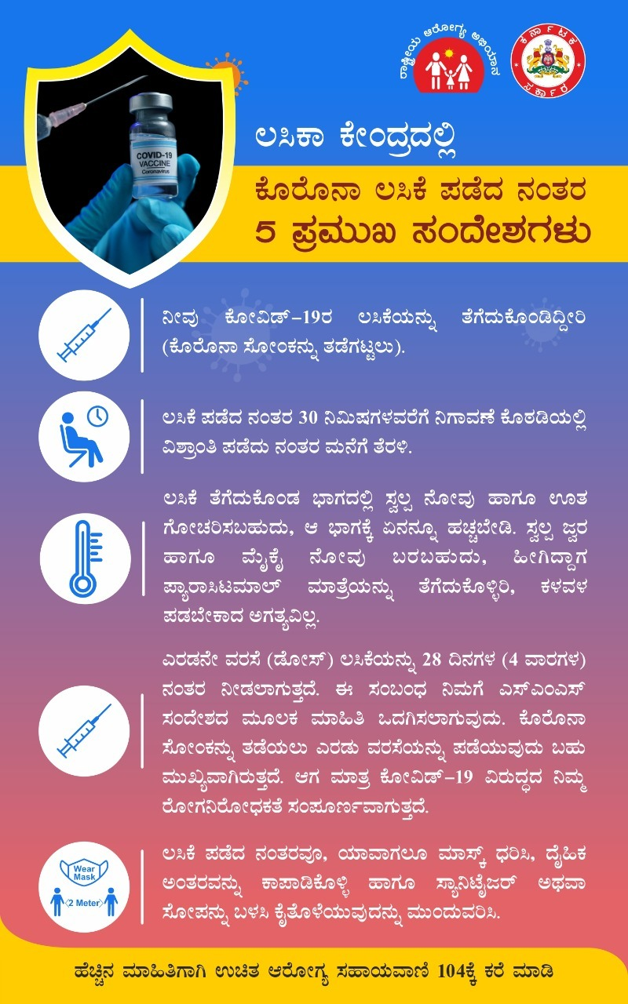
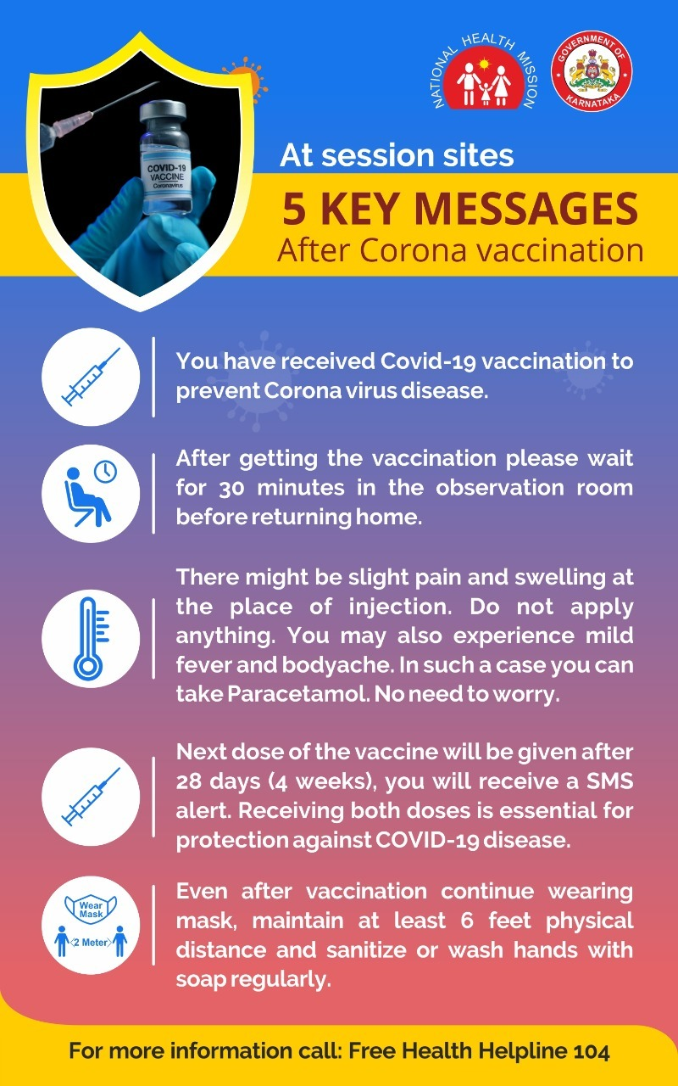
5 Key Messages

Slide 40
MANAGING AEFI
Ensure all vaccine recipients wait at the session site for 30 minutes after vaccination
After vaccination, inform the vaccine recipient
  About minor events which may occur - mild to moderate fever, local pain and swelling at injection site, malaise etc.
    Tablet Paracetamol SOS with a minimum interval of 6 hours between two doses
    Visit nearest health facility, if minor adverse event persists beyond 2-3 days
  For any other severe / serious event, immediately refer to a secondary or tertiary care health facility
An anaphylaxis kit with injection adrenaline within expiry date should be available at the outreach session site
Use anaphylaxis kits available at the session site for immediate management of suspected anaphylaxis.
The Medical Officer should be informed immediately by telephone
Contact numbers of ambulance services should be available with the vaccinator team (102, 108 etc)

Slide 41
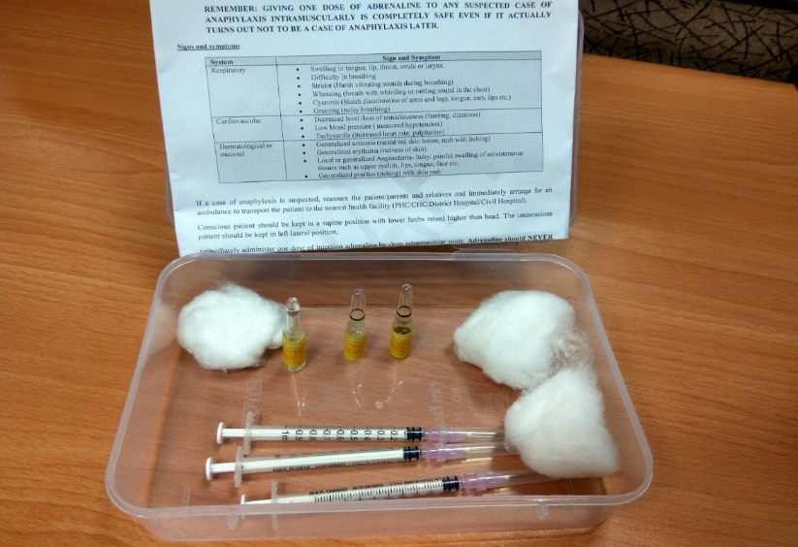
Initial management of Anaphylaxis
Suspected anaphylaxis:
Early onset and rapid progression of symptom
at least one sign/symptom related to at least two of the following three systems
  respiratory (swelling of tongue, lip, throat; noisy breathing or difficulty in breathing with harsh sounds/whistling/rattling sound in chest, bluish discoloration of arms and legs, tongue, ears, lips, etc.)
  cardiovascular (fainting, decreased level /loss of consciousness, low blood pressure, increased heart rate, palpitation)
  dermatological/mucosal (skin-related like raised red skin lesion, rash with itching over body, itchy/ painful swelling of subcutaneous tissues such as upper eyelids, lips, tongue, face etc.)
Figure 2: Anaphylaxis Kit with instructions manual

Slide 42
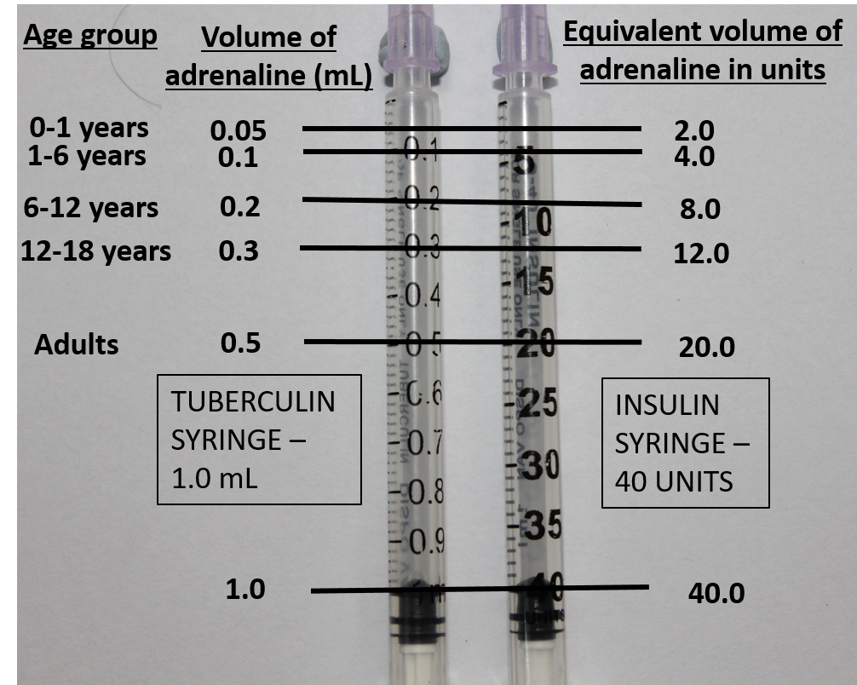
Initial management of Anaphylaxis
Adrenaline is the drug of choice to treat anaphylaxis
Age (in years) | Needle for intramuscular injection | Age specific dose of adrenaline (1:1000) in ml (tuberculin) or units (insulin)
Adults | 1 inch long of 24G or 25G | 0.5 ml / 20 units
12-18 |  | 0.3 ml / 12 units
6-12 |  | 0.2 ml / 8 units
1-6 |  | 0.1 ml / 4 units
0-1 |  | 0.05 ml / 2 units
Table1: Age specific dose of Adrenaline
Figure 3: Markings of age-appropriate dosage of adrenaline in mL (tuberculin syringes) and equivalent volume in units (insulin syringes)

Slide 43
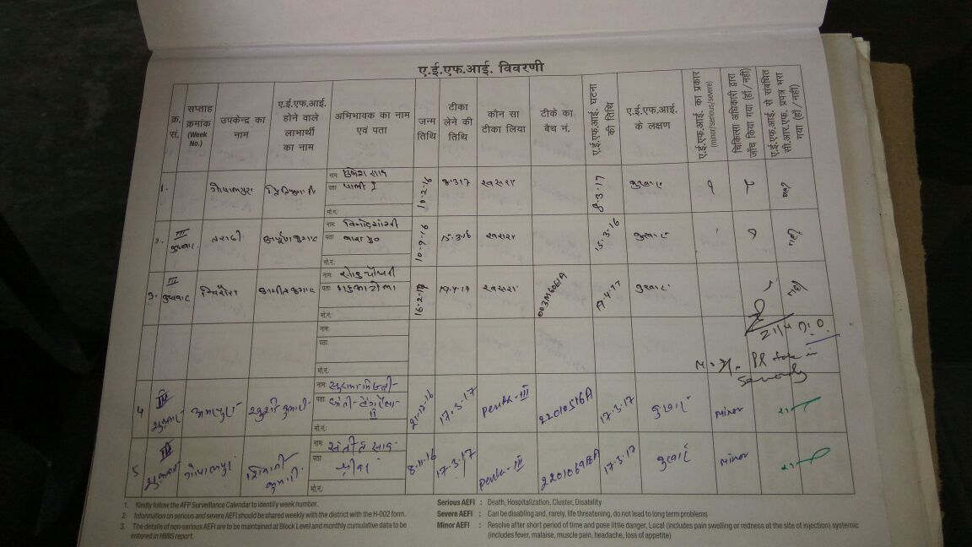
Recording of AEFI
Immediate Reporting: all serious and severe AEFIs to the supervisor and medical officer
Co-WIN: all (minor, severe and serious) adverse events, against the respective beneficiary names
AEFI registers: all (minor, severe and serious) adverse events in the AEFI register
AEFI recording register
Reporting and investigation of cluster AEFI cases
Cluster: two or more cases of the same adverse event related in time, place or vaccine administered
Immediately inform the supervisor and medical officer

Slide 44
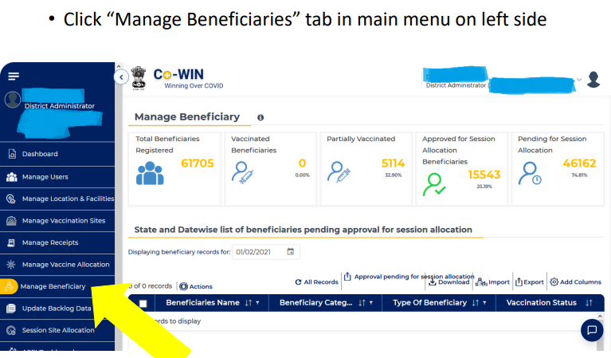
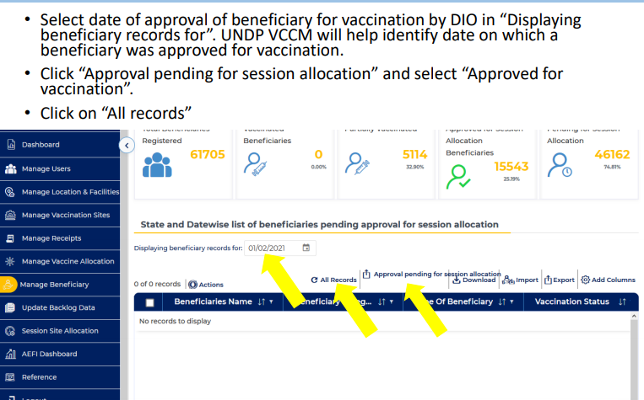
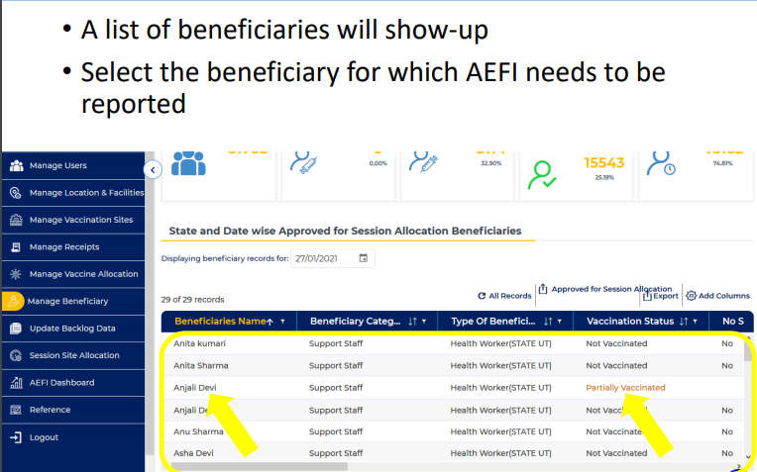
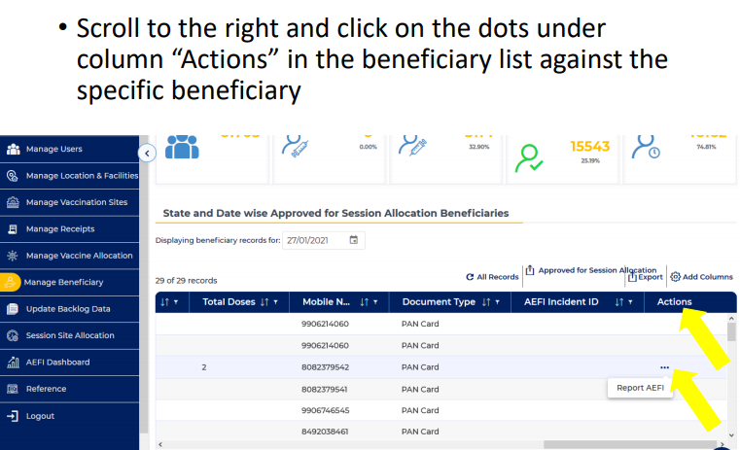
Reporting of AEFI case in Co-WIN

Slide 45
Gaps and improvements
Based on the initial roll out of COVID 19 vaccination programme, some of the key aspects of AEFI surveillance are-
Ensure that the post-mortem of a suspected death case following COVID 19 vaccine is conducted at the nearest Medical College Hospital or at the district level by a Forensic expert and Pathologist.
The process of post-mortem examination (external and internal) should be videographed, and
The tissue samples (viscera) should be sent for histo-pathological examination in all cases and for toxicological analysis in specific cases to the designated medical college/forensic science lab for analysis and followed up for early submission of reports.
District AEFI Committees should meet more frequently, to undertake the investigation of AEFI cases post COVID-19 vaccination.
RCH Officer to ensure all the serious/severe AEFI cases are investigated as per the COVID 19 guidelines and submission of case records (along with hospital records, PM report and verbal autopsy form) is done in COWIN SAFEVAC

Slide 46
AEFI Reporting
Follow all safe injection and immunization practices at the session site. Ensure that due verification of the beneficiary for the contra-indication of COVID 19 vaccine is done before administration
All vaccine recipients should be asked to wait at the session site for 30 minutes after vaccination
Convey expected AEFIs to the vaccine recipient and explain that in case of any AEFI, the vaccine recipient should contact the nearest health centre for treatment
Beneficiaries displaying signs and symptoms of anxiety should be appropriately managed and the medical officer to be informed of such cases
Use injection adrenaline to manage any suspected anaphylaxis case at the session site and arrange for immediate transportation to the nearest health facility/AEFI management centre

Slide 47
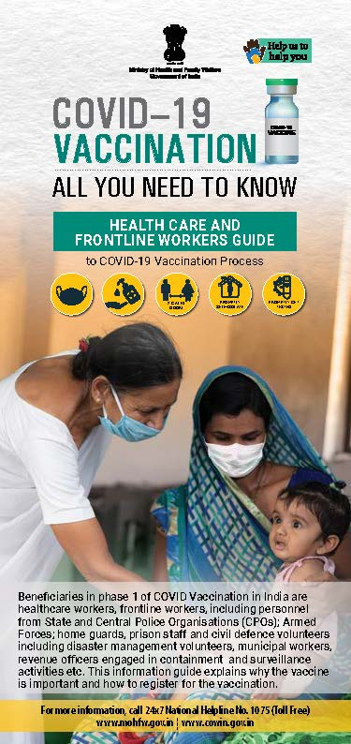
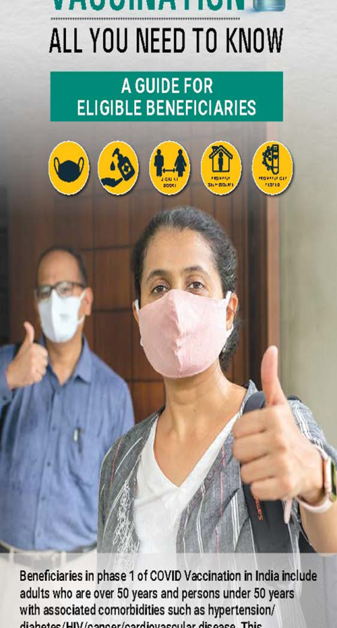
Infodemic: Fake news through social media
Affects vaccine confidence and adding to vaccine hesitancy
Social media including WhatsApp and Telegram being used to fan rumours
Online media narratives shape traditional media opinions
Ease of sharing – everyone is a newsmaker as no control
Notes:
Definitions
-Fake News- purposefully crafted, sensational, emotionally charged, misleading or totally fabricated information that mimics the form of mainstream news
-Misinformation - false information that is spread, regardless of whether or not there is intent to mislead
-Disinformation - deliberately misleading or biased information; manipulated narrative or facts; propaganda
- All countries are keeping a close watch on each other to keep a track of Vaccine research launch plans. Indian Media too has been reporting extensively on global developments and global fake news has also found its way into India.

Slide 48
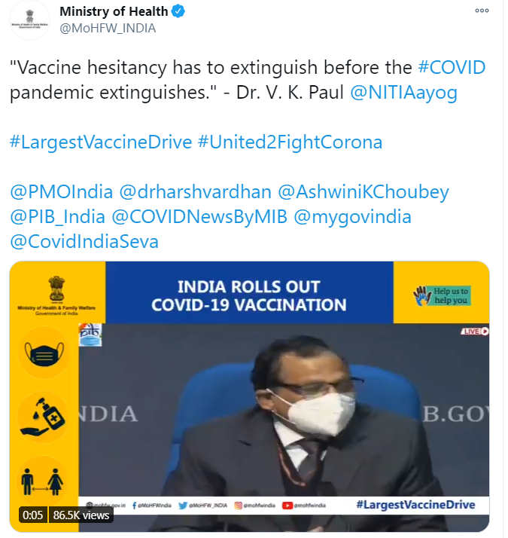
Countering vaccine hesitancy through Media
Showcase of positive stories /testimonials of vaccine beneficiaries
Interviews, sound-bytes of experts, scientists sharing information on vaccine efficacy
Having vaccine selfie stands will motivate others
Notes:
Links:
https://twitter.com/MoHFW_INDIA/status/1351561427388022784
https://twitter.com/MoHFW_INDIA/status/1351562523217022976
PIB Fact Check
https://twitter.com/PIBFactCheck/status/1350842525695705088

Slide 49
Communicating to next Target Group
(>60 years and 45-59 yrs with co-morbidities)
Communicate clearly about the entire vaccination process of where, when, and how
Spread awareness on how to register, contraindications for vaccination on portal
Create awareness about walk-in process, documents required
Reach out to groups who are not so tech-savvy and that it is not compulsory to register on portal
Explain about co-morbidities and contraindications in simple to understand language to target population

Slide 50
Social Mobilisation
Focus on social mobilisation and community engagement through different platforms. Ensuring clear guidance on the processes is available to general public
Address fears and perceptions of target communities through quality inter-personal communication by vaccinated and other local influencers
Organize community events, training meetings in all areas including urban slums involving local elected representatives, religious leaders, private doctors
For strengthening community engagement, engage CSOs and CBOs, FBOs, Local celebrities / influencers at all levels.

Slide 51
Co-ordination at Session sites
Ensure adequate facilities at session sites:
  considering majority of beneficiaries will be senior citizens
  Waiting area, seating arrangements
  Information desk
  Proper IEC in the district
Proper communication, information is very crucial, particularly during the first week. If we start well, it will carry a very positive message and impact going forward

Slide 52
THANK YOU

