Slide 1
COWIN 2.0 SITE MANAGER – SESSION CREATION & USER CREATION

Slide 2
www.cowin.gov.in

Slide 3
Enter User Id and Password to Log in

Slide 6
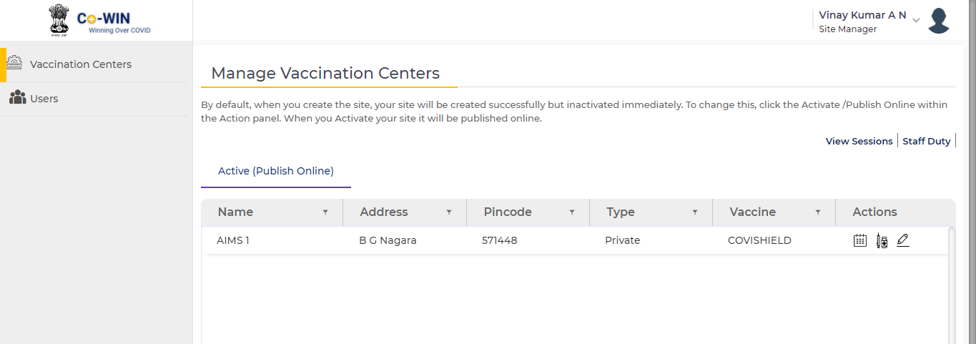
Manage Session
Update Vaccine Batch

Slide 8
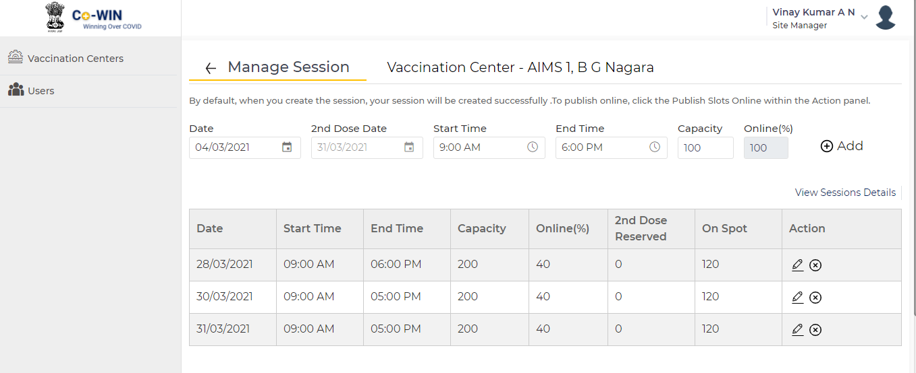

Slide 9
